Slide 1


BCA
SEC 2
(SEM 5)
PROJECT PRESENTATION
REVIEWER
MS. RATNA SINGH

Slide 2

GROUP MEMBERS
<
RAJNISH PAL
RAHUL MISHRA
<

Slide 3
^{TOURISM MANAGEMENT SYSTEM}

Slide 4
Introduction
Tourism Management System is an integrated software developed for tourism business. It is a dynamic and responsive system and it addresses the challenges of managing the records, missing records due to human errors, etc. The purpose is to build a system that performs all operations related to traveling, booking, sightseeing, etc. This system connects customers and agents directly, provides a feedback mechanism for tourists, maintains and controls the database of tourists’ information, and gives a variety of travel services.

Slide 5
WHY WE NEED TOURISM MANGEMENT SYSTEM
Challenges in the existing system
The user needs to visit the travel agency office to plan any tour.
It involves a lot of manual paperwork, and customers need to stay
in the queue for a long time.The present systems are inadequate in providing information and advice to the agencies and customers about tour plans. Most of the time agencies have to rely on local information sourcesand their own experience regarding time and cost. Through a phone call, they have to get information. There are some problems that exist in traditional systems

Slide 6
FEATURES OF OUR TOURISM APPLICATION
Privacy and Confidentiality
Effective during emergency conditions.
It saves time and effort.
Easy updation of records

Slide 7

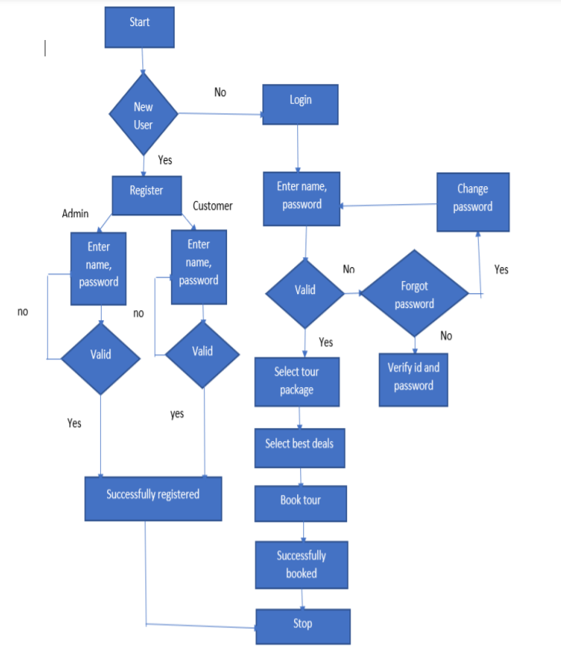
FLOWCHAT OF THE SYSTEM

Slide 8
SNAPSHOT OF TOURISM MANAGMENT SYSTEM
Text here
Text here
Text here

Slide 9
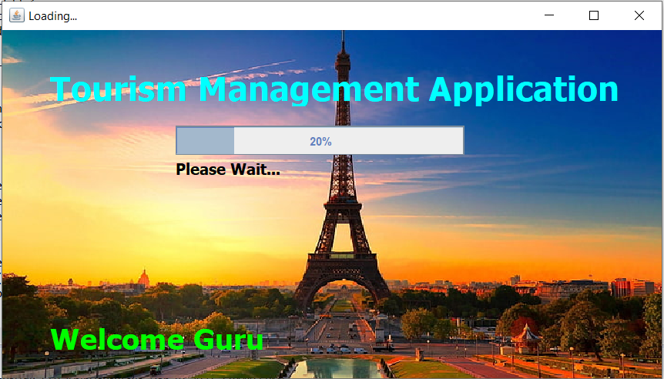

Slide 10

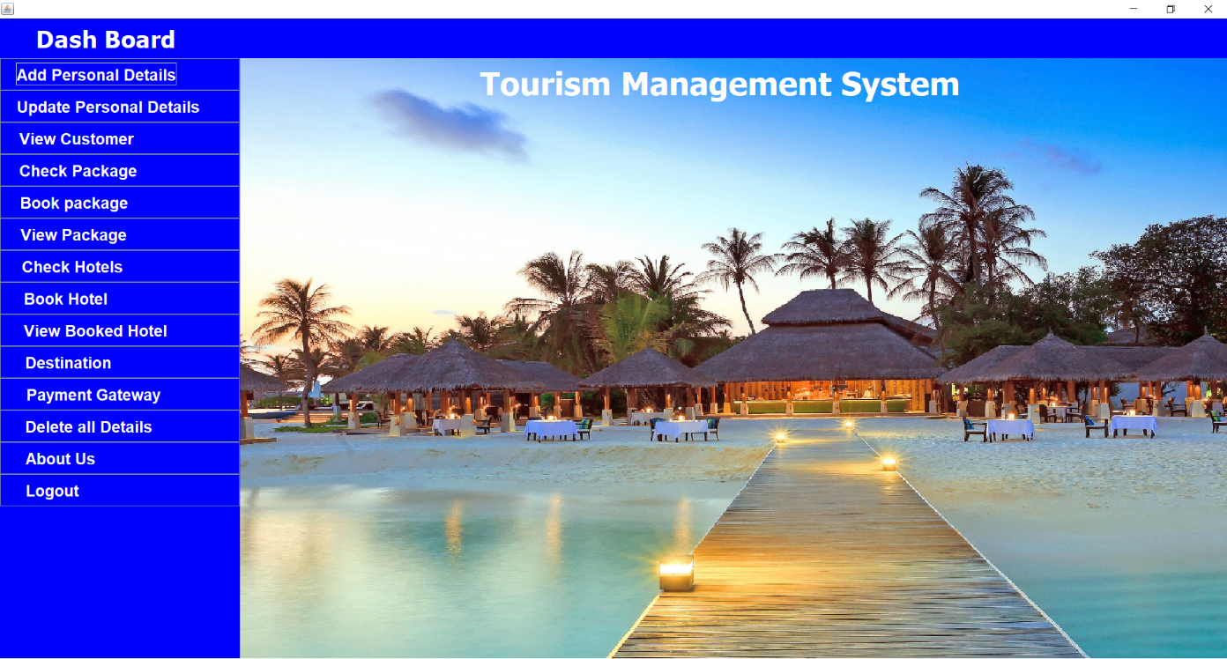

Slide 11

Tourism is currently recognized as a global industry that is growing at a high rate, like any other industry. This web-based application helps in maintaining the database. It has a friendly environment that connects customers willingly. Thus, it simplifies the process by saving our time and efforts. It will help tour managers to control and handle the tour-related activities effectively and efficiently. A further modification could be possible where the system can be integrated with bigger organizations such as tourist agencies in order to help them.

Slide 12
THANK YOU

